Slide 1

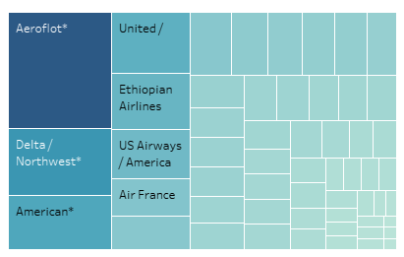
Incidents per Airline
Majority of airline incidents occurs with Aeroflot
Excluding Aeroflot, most airlines share approximately similar distributions of incidents

Slide 2
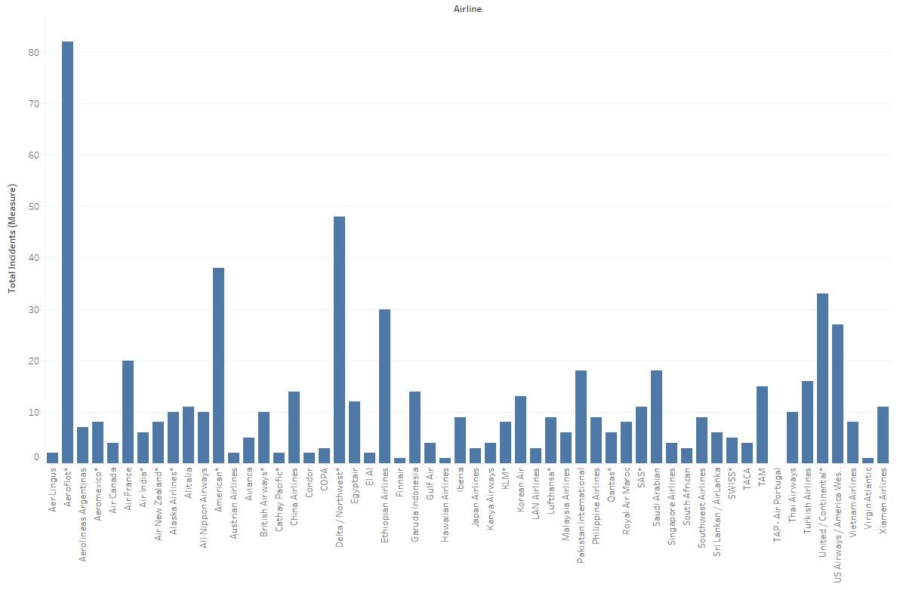
Incidents per Airline
Majority of airline incidents occurs with Aeroflot
Mainstream airlines experience more incidents, likely due to increased popularity and therefore number of planes in the sky

Slide 3
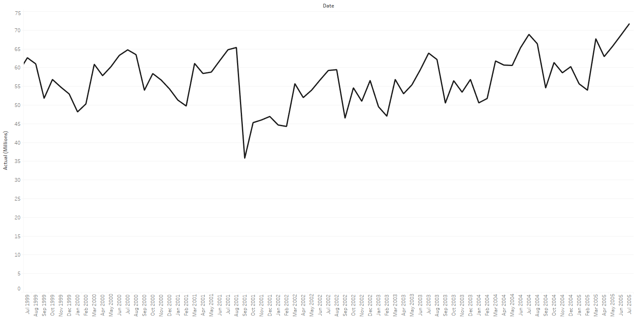
Airline Passengers per Month (1999-2005)
Number of passengers has been rising from 1999 to 2006
The terrorist attacks on 9/11 caused a temporary dip in the number of passengers flying

Slide 4

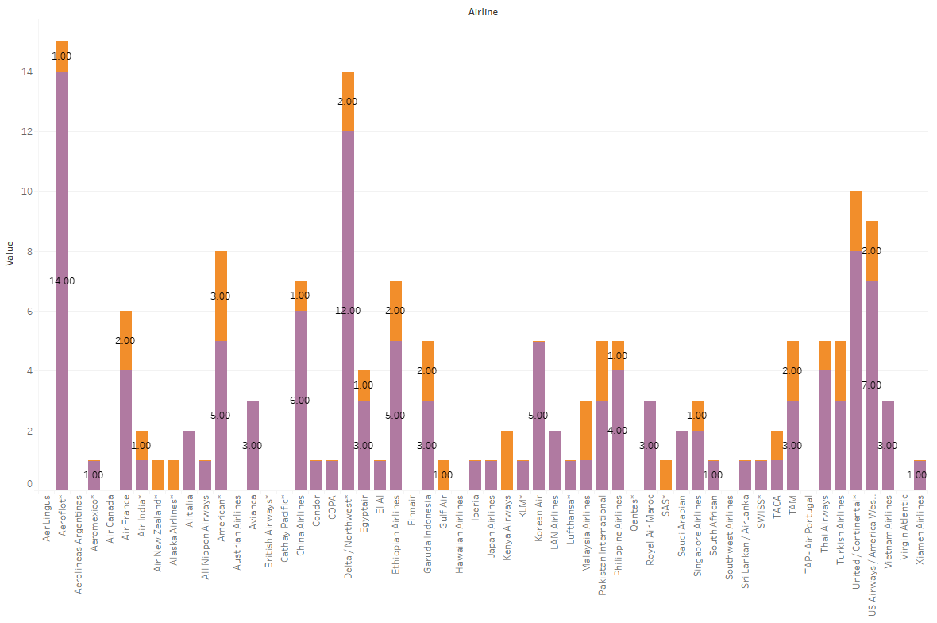
Fatal Accidents per Airline
Number of fatal accidents was lower from ’00-‘14 than it was from ’85-‘99

Slide 5

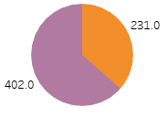
Incidents (’85-’99 vs ’00-’14)
Proof that total number of incidents in ‘00-’14 was less than it was from ’85-’99
This indicates that flights are experiencing less incidents than in the past, and might therefore actually be safer today.

Slide 6

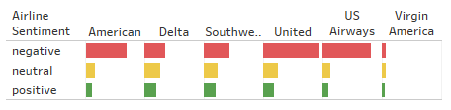
Airline Sentiment
Overall Sentiment
NEGATIVE
Overall airline sentiment is negative.
Majority sentiment for each individual mainstream airline is also negative
NEUTRAL
POSITIVE
Sentiment by Airline

